Slide 1
Donau valsen
Johann Strauss II
arr. Vaia Zannou

Slide 2
Bilden: musication.com

Slide 3
Bilden: musication.com

Slide 4
Bilden: musication.com

Slide 5
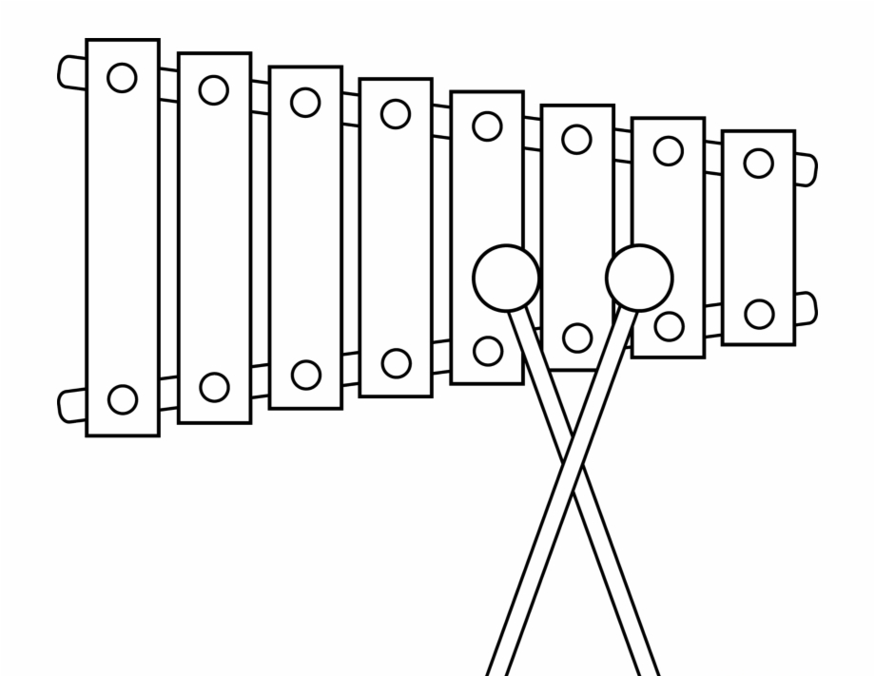
Xylofon
1
2
3
4
A A
A A
GG
GG
E
E
C
C
C C
D
D
B B
B B
5
6
7 8
A___
GG
GG
G___
E
E
E___
C C
E___
C C
C___

Slide 6
Altblockflöjt
1 1 1 1 2-1 2-1 2-1 2-1 2-1 2-1 2-1 2-1 1 1 1 1
1 1 1 1 2-1 2-1 2-1 2-1 2-1 1 1 2-1 1

Slide 7
Sopranblockflöjt
3 3 3 3 3 3 3 3 2 2 2 2 2 2 3 3
3 3 3 3 2 2 2 2 2 3 2 3 3

Slide 8
Tenorblockflöjt
2-1 2-1 2-1 2-1 1 1 1 1 1 1 1 1 2-1 2-1 2-1 2-1
2-1 2-1 2-1 2-1 2-1 2-1 2-1 2-1 2-1 2-1 2-1 1 2-1

Slide 9
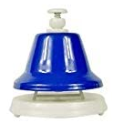
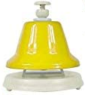
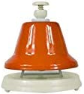
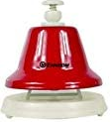
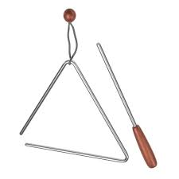
Handklockor, cymbal, triangel

